Slide 2
1. Who we are?
2. Evolution
3. Organization chart
4. What makes us different?
5. ISO Certification
6. Quality
7. Top customers
8. Performance
SHORT COMPANY PRESENTATION

Slide 3
1. WHO WE ARE
Aldestar Top Transport was founded în 2012, in Mioveni-Romania, as a family business;
We offer express transport services, FTL, groupage;
OPERATIONAL GEOGRAPHICAL AREAS | %
DOMESTIC | 5
EUROPE | 70
ASIA (TURKEY) | 25
TRANSPORT METHOD | %
Full truck load (FTL) | 30
Express transport (van) | 70
We have our own fleet
54 trucks & 62 mega semitrailers, 160 vans MMTA 3.5 TO, plus 40 vans MMTA 3.5 TO from dedicated ALDESTAR subcontractors;
Our team is made up of approximately 250 employees;
We have an external communication through 24 transport operators speaking English, French, Spanish, German, Italian, Turkish
Our availability is 24/7;
We moved in our new headquarter placed in Bascov where we have our own parking and maintenance service;
We celebrate over 10 years of success in domestic and international express transport field;

Slide 4
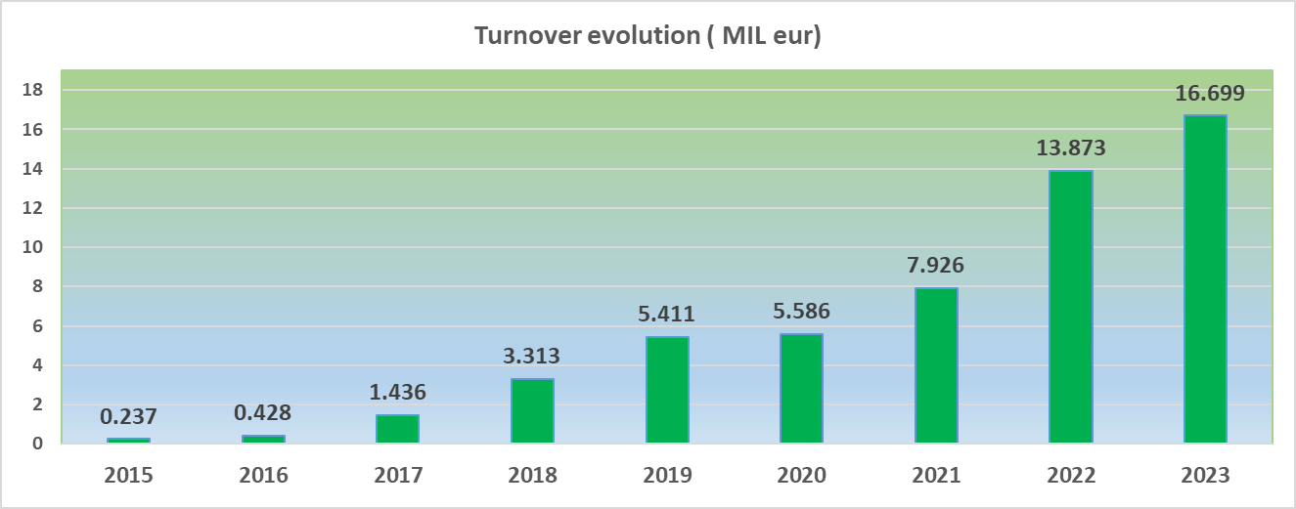
2. EVOLUTION
a). Turnover evolution (MIL euro)

Slide 5
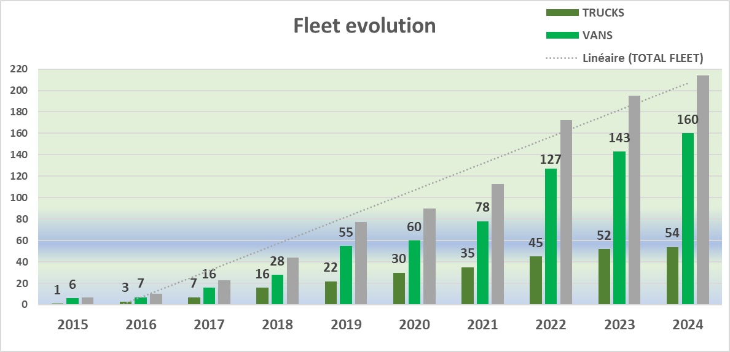
2. EVOLUTION
b). Fleet evolution
7 camioane
&
16 Va uri
1
7 Va uri
camion&
6 Va uri
0 5
0 6
2017
2018
Our whole fleet has the latest generation GPS system;
Average age trucks: 3 years (Euro E5 & E6);
Cargo insurance : AGGREGATED 2.000.000 Eur & 600.000 EUR/event;
Integrated system for monitoring driving mode and fuel consumption;

Slide 6
2. EVOLUTION
c). Investments made in the last 4 years
Secured parking 20 000 sqm, which can accommodate at the same time 80 trucks and 100 vans;
Service for the maintenance of our own fleet;
1
7 Va uri
Management warehouse of 500 sqm;
Management offices of 440 sqm
Digitization;

Slide 7
3. ORGANIZATION CHART
We are a young and ambitious team that, 10 years ago, we stubbornly believed in our lucky star and used all our ambition and skill to build the right company for our vision.
CEO
FINANCIAL MANAGER
OUTSOURCING
INTERNAL AUDIT
MTA CONSULTIING
OUTSOURCING
EXECUTIVE
MANAGER
FINANCIAL
MANAGER
COMMERCIAL MANAGER
TRANSPORTS DEP.
MANAGER
TECHNICAL MANAGER
ACCOUNTANCY TR. DEP.
FINANCIAL ACCOUNTING DEP.
INVOICING
DEP.
HUMAN RESOURCES
DEP.
IT
DEP.
HEAD COORDINATOR
TRUCKS TR.DEP.
HEAD COORDINATOR VANS TR.DEP.
HEAD COORDINATOR SPAREPARTS ACQUISITION
HEAD COORDINATOR
SERVICE MAINTENANCE
HEAD COORDINATOR
TRUCKS+ SEMITRAILERS
HEAD COORDINATOR VANS
ADMINISTRATIV DEP.
OPERATIONAL DEP.
WAREHOUSE DEP.
MECHANICS
DRIVERS
MONITORING DEP.
DRIVERS
ORDERS REG. DEP.
30 years average age for the operational team
38 years average age for the drivers

Slide 8
4. WHY WE ARE DIFFERENT?
Our know-how :
Valuable professional experience;
Stable resources (operational team and drivers);
Efficiency and quality of the services provided;
Deliveries in maximum 24 hours from RO /to Hungary, Slovenia, Austria, Italy (North), Czech Republic, Slovakia, Poland, Bulgaria, Greece, Turkey (23 CEMT authorizations).
Deliveries in maximum 48 hours from RO to: Germany, France, Switzerland, Italy (South), Belgium, Netherlands, Spain (North)
Deliveries in maximum 60 hours from RO to: Spain (South), Portugal, Morocco.
Effective communication with our customers
to track collaboration feedback.

Slide 9
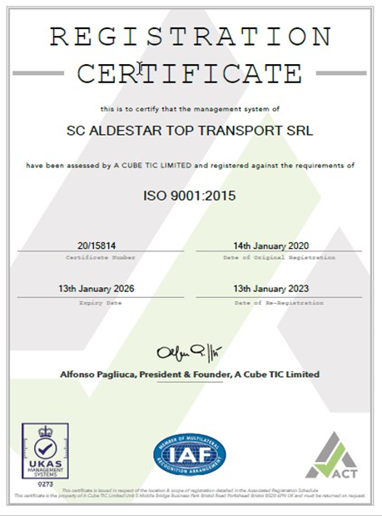
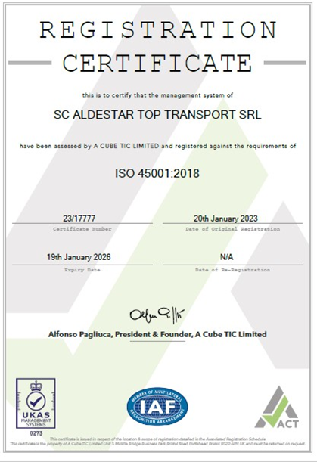
5. QUALITY
ISO certifications:

Slide 10
6. VISION
The result of our work and skill is a dynamic, strong and serious company, which is constantly looking to the future.
Aldestar Top Transport business vision follows two main directions
To identify
new business opportunities(B2B)
To invest
In employees and vehicles
Digitization

Slide 11
7. ORDERS MADE IN 2023 FOR TOP 20 CUSTOMERS FROM AUTOMOTIVE INDUSTRY
1142 MERCEDES BENZ GMBH
1082 RENAULT
986 ROBERT BOSCH
916 FORD CRAIOVA
846 VOLKSWAGEN AUTO EUROPA GMBH
769 VALEO
636 DACIA
604 FAURECIA
527 SKODA AUTO AS
449 VOLVO POWERTRAIN CORPORATION
396 BMW GMBH
324 FBP-FOUNDATION BRAKES
230 BASF CATALYSTS GERMANY GMBH
206 MAGNETI MARELLI
190 HELLA DISTRIBUTION GMBH
177 SCANIA
142 PILKINGTON AUTOMOTIVE
138 SUMITOMO RUBBER FALKEN
134 LISI AUTOMOTIVE NOMEL S.A.S.
116 GÖLLNER LAGER

Slide 12
8. PERFORMANCE
Recognized seriousness

Slide 13
Flota Aldestar Top Transport

Slide 14
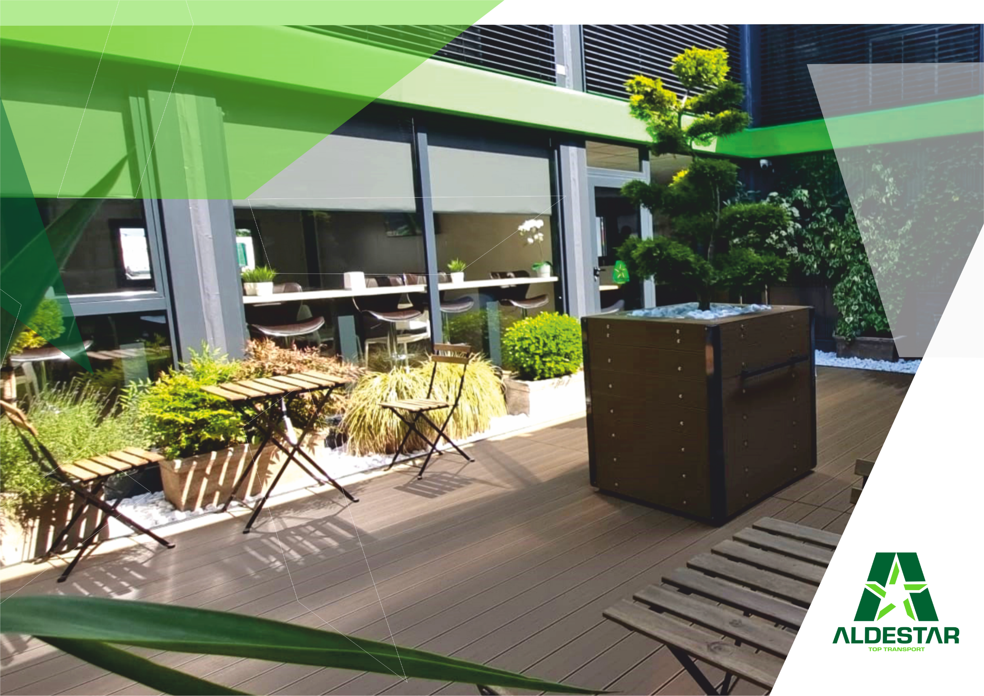
New headquarters of Aldestar Top Transport

Slide 15
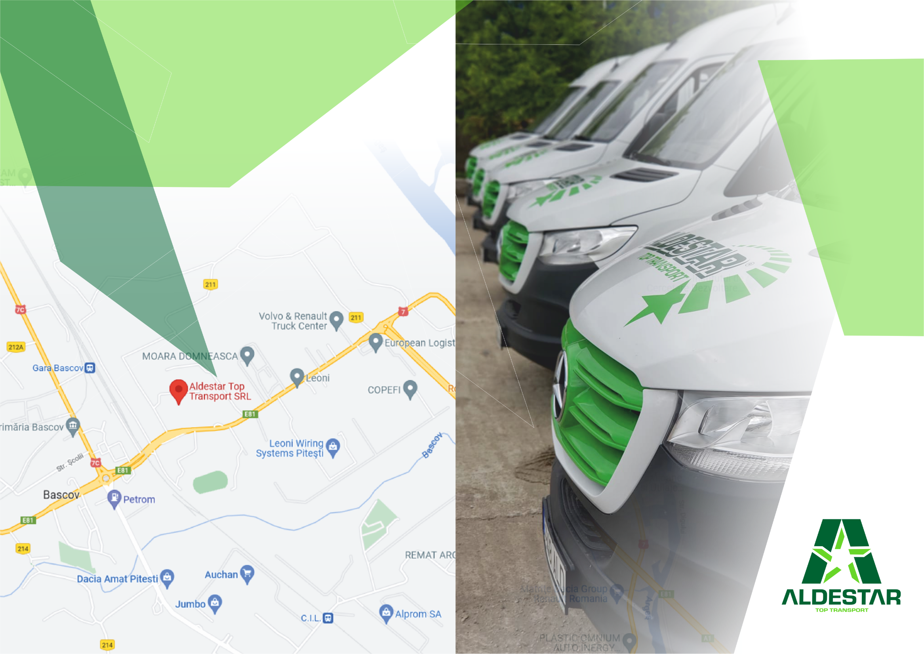
CONTACT
Serelor 55, Bascov, Argeș, RO 117045
office@aldestar.ro
+40 372 66 77 00

